Slide 1

Core principles
ASP.NET Core WebAPI

Slide 2
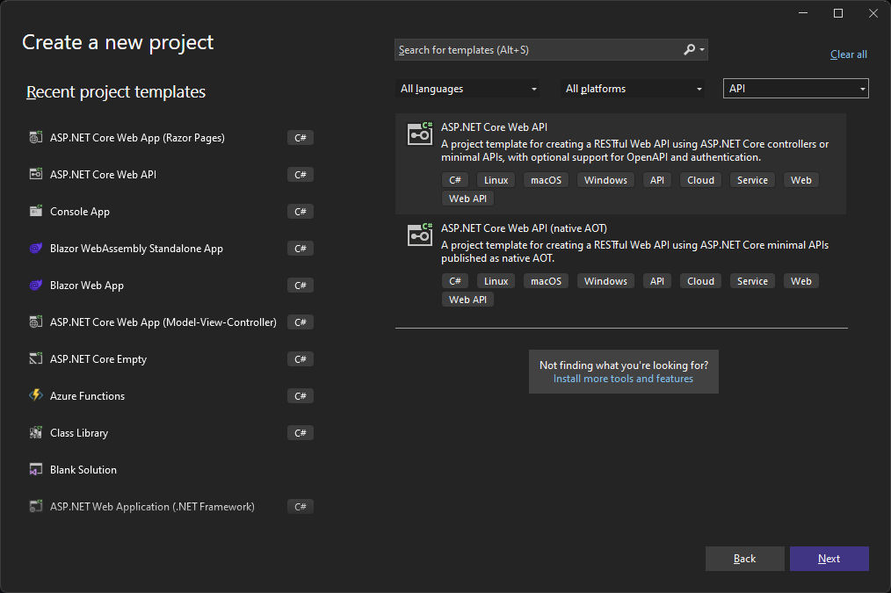
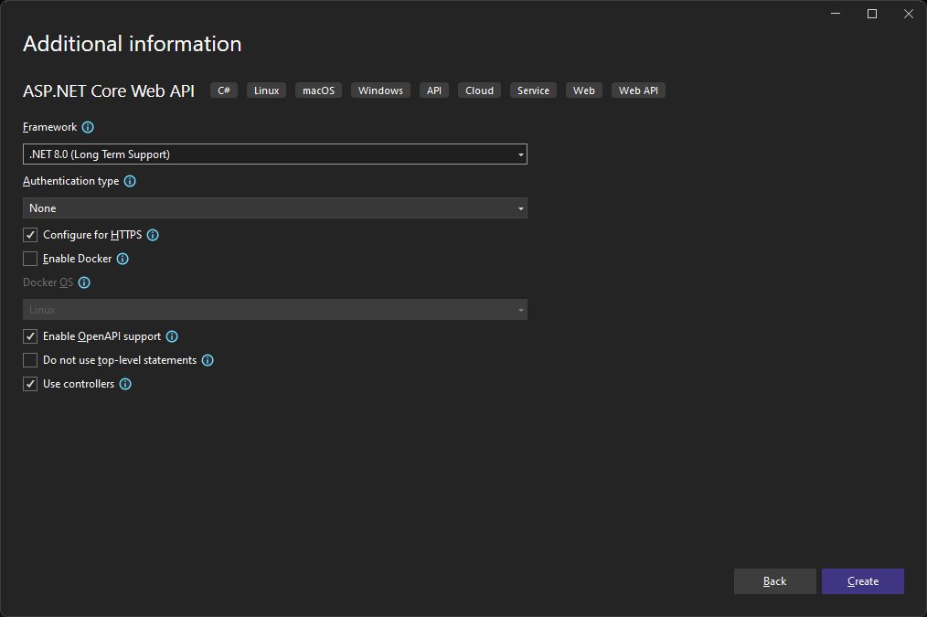
File → New Project…

Slide 3
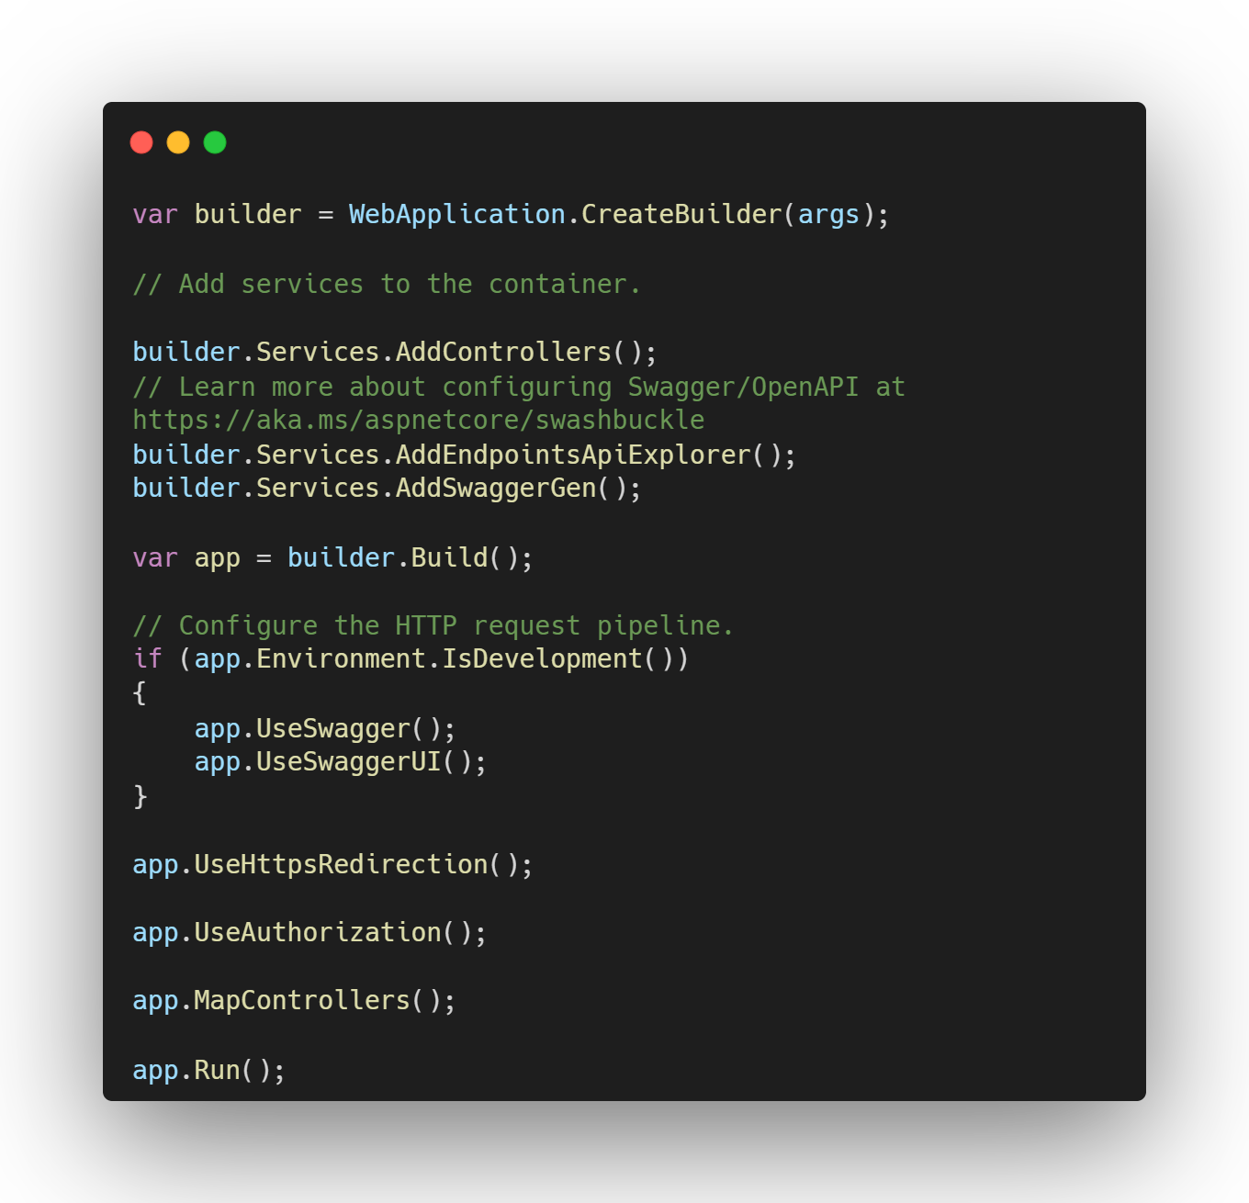
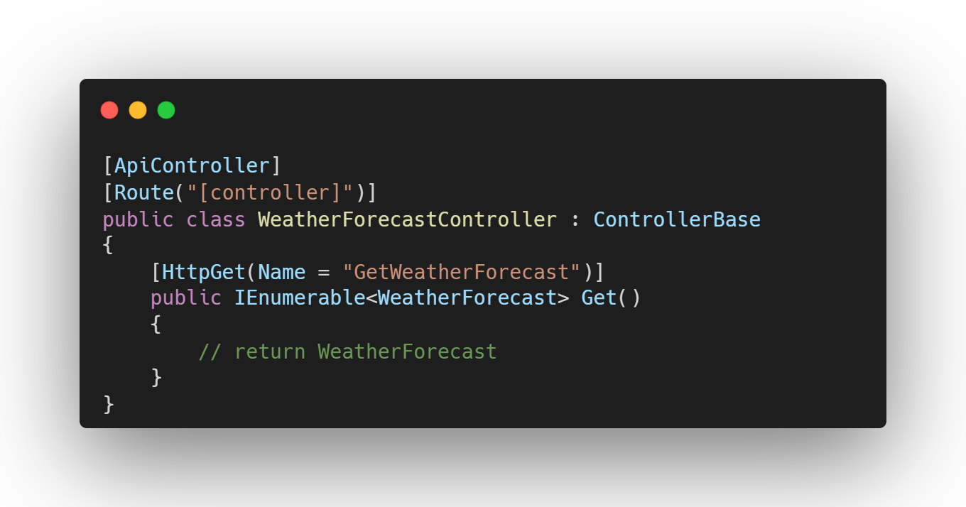
File → New Project…
Program.cs
Controllers/WeatherForecastController
👈
👈
👈
👈
👈

Slide 4
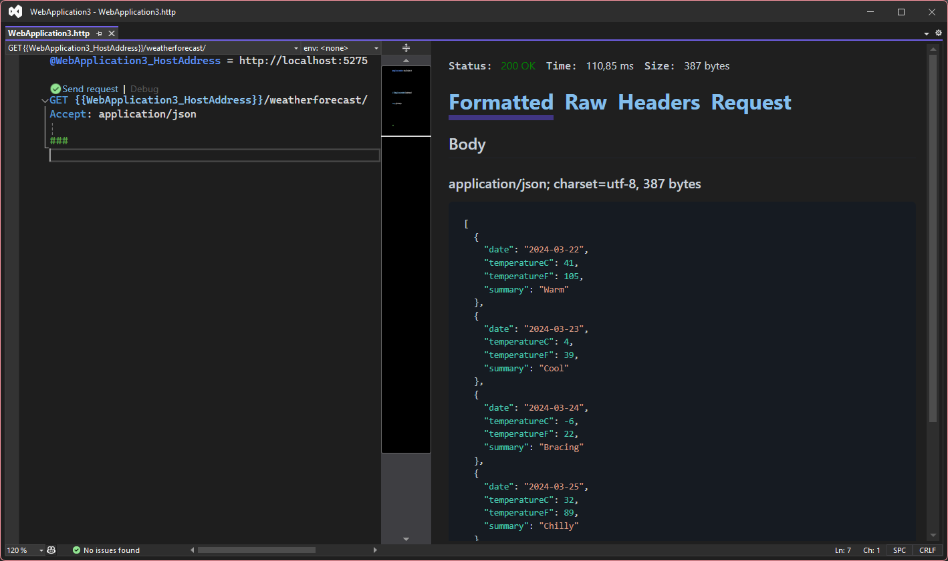
File → New Project…
WebApplication.http
Notes:
Hit F5

Slide 5
The MVC pattern
Model
View
Controller
MVC: Model-View-Controller
Model: data and business logic
View: presentation of the data to the end user
Controller: interaction between view and model
Language agnostic UI pattern, that tackles:
Separation of concerns
Testability
Reuse
2009: release of ASP.NET MVC 1.0 as an alternative to ASP.NET WebForms to build Server Side Web Applications
2012: release of ASP.NET Web API 1.0 as an alternative to WCF to build REST APIs
Notes:
Reuse: view components, models, controller logic, …

Slide 6
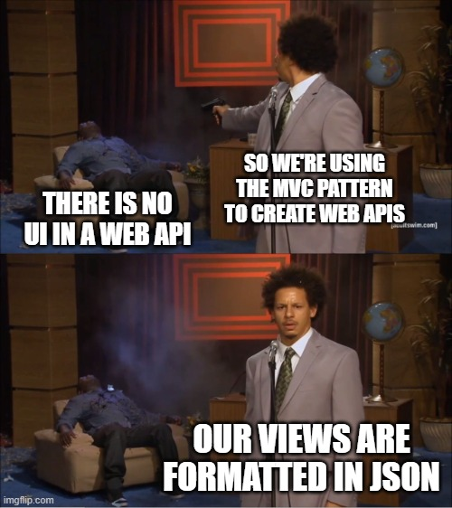

Slide 7
Lab Setting up the endpoint
ASP.NET Core Empty template
Add Controller support
Create the Controller
Create the Model
Use the Model in our Controller
Testing our API with a .http file

Slide 8
Lab Review
Web Application Builder
Middleware pipeline
Model
ControllerBase
APIController attribute
Route attribute
HttpGet

Slide 9
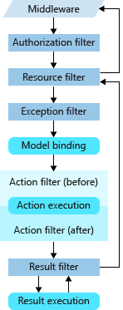
Hosting our app
During startup, a Host is built by ASP.NET Core, encapsulating:
The HTTP server
Middleware Components
Logging
Dependency Injection
Configuration
Different host options:
ASP.NET Core WebApplication 👈
.NET Generic Host (+ ConfigureWebHostDefaults)
ASP.NET Core WebHost
Notes:
Order matters

Slide 10
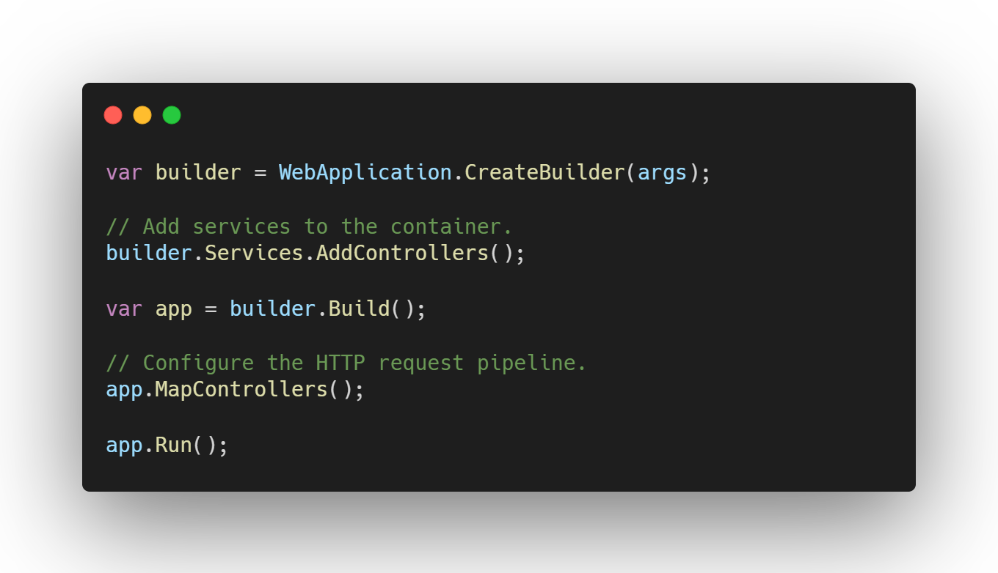
Hosting our app
ASP.NET Core WebApplication (aka Minimal Host):
Recommended for Web APIs in ASP.NET Core
Builds on .NET Generic host
Default options:
Uses Kestrel as the web server (and enable IIS)
Loads Configuration (appsettings.json, environment variables, command line args, …)
Sends logging to console and debug providers
Notes:
Kestrel: cross platform web server

Slide 11
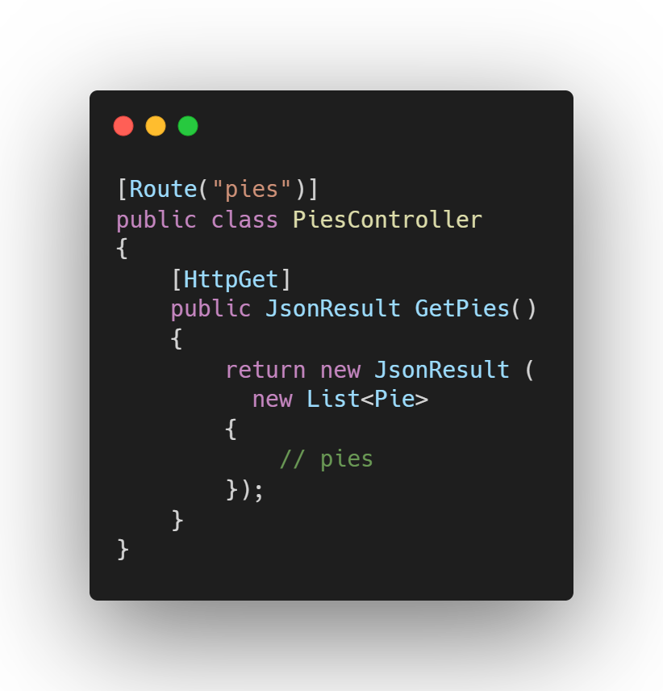
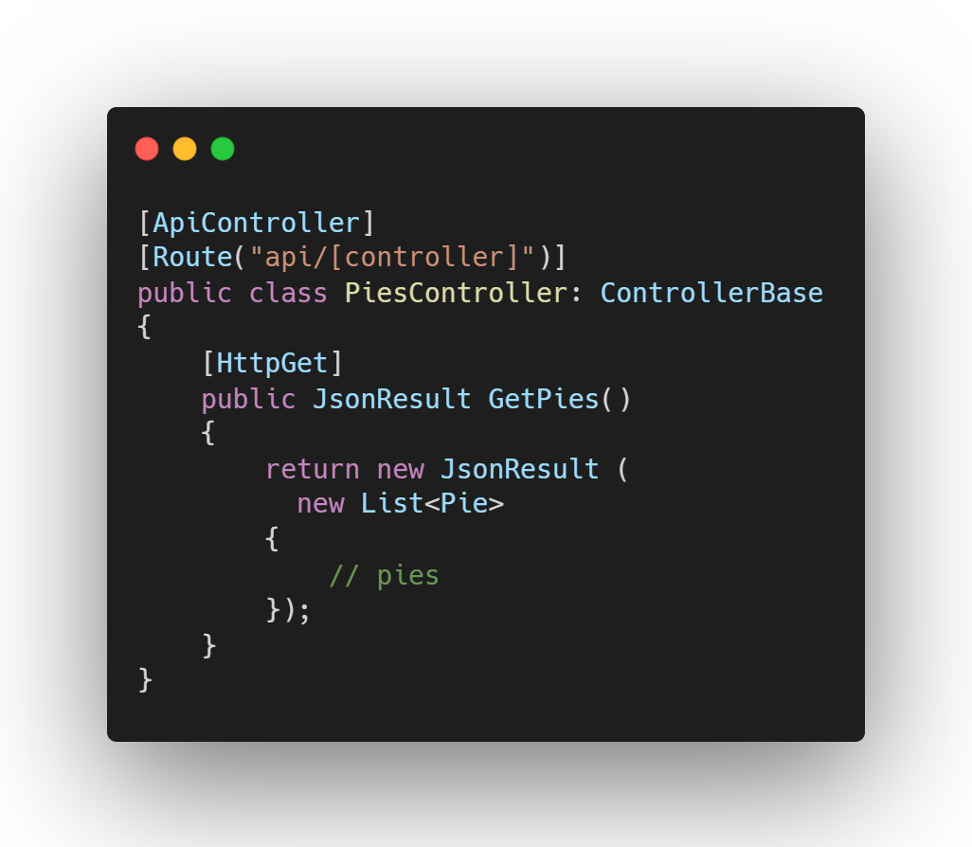
Exposing an Endpoint
Route attribute
Controller level: Base route for our endpoint
Method level: Sub part of the route for the action
Route(“[controller]”): convention-based routing
HttpGet attribute
Tells the endpoint middleware that the action supports HTTP Get
Convention-based routing or Route attribute on action
ControllerBase
Base class for MVC controllers without view support
View support needed? Use Controller as a base class
APIController attribute
Indicates that the class will serve HTTP API responses
Enables opioniotated API behaviors
Goal: improve developer experience
Notes:
Other conventions:
“[Action]”
“[Area]”
API behavior with APIController:
Attribute routing requirement
Automatic HTTP 400 responses
Binding source parameter inference
Multipart/form-data request inference
Problem details for error status codes

Slide 12
Lab Adding more methods
Add an inline data store for our pies
Add the GetById method
Add the SearchPie method

Slide 13
Lab Review
Route parameter (int id)
Route constraints
Query string parameter
Http status codes

Slide 14
Model binding
Controllers work with data from the HTTP requests:
Route data 👈
Query string 👈
Request body
Form fields
Headers
Uploaded files
👈

Slide 15
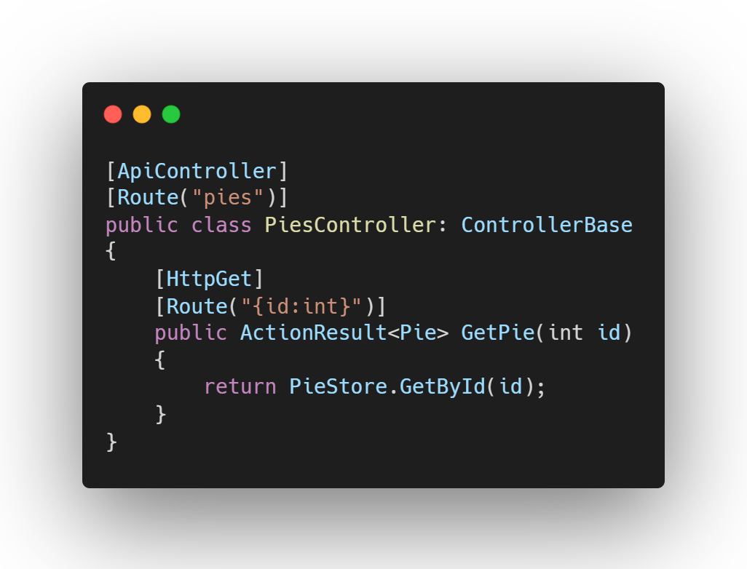
Model Binding Route data
🌐 GET https://api.pieshop.com/pies/1
❗Only simple types are supported ➔ types that can be converted to string
Method
Domain
Route

Slide 16
Model Binding Route data
🌐 GET https://api.pieshop.com/pies/1
🛑 Route constraints:
Checks the route parameter before binding
Type constraints (e.g. {id:int}, {price:decimal})
Logical constraint (e.g. {age:min(18)}, {name}
Returns a HTTP-404 – Not Found response
Don’t use for validation (HTTP-400 Bad Request)
Full list of constraints

Slide 17
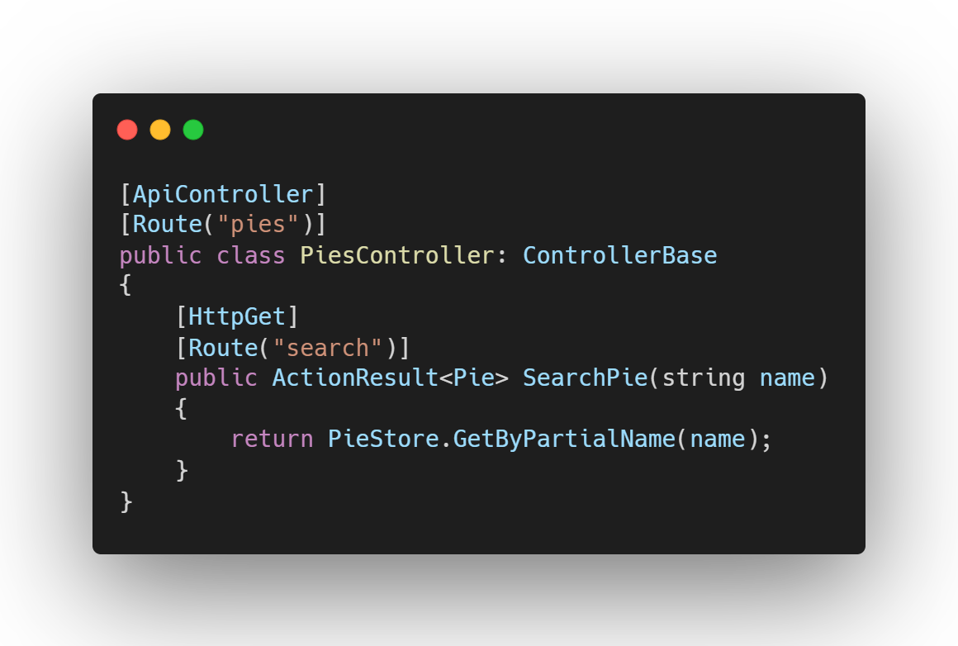
Model Binding Query string
🌐 GET https://api.pieshop.com/pies/search?name=cherry
?: precedes the query string
Key/Value pairs
Key: name
Value: cherry
&: multiple key/value pairs
name=cherry&page=1&skip=10
%XX: special characters are encoded
%20: space ➔ name=cherry%20pie
Method
Domain
Route
Query String

Slide 18
HTTP Status codes
2xx Success
200 - OK
201 - Created
4xx Client Error
400 - Bad Request
401 - Unauthorized
5xx Server Error
204 - No Content
403 - Forbidden
500 - Internal Server Error
404 - Not Found
405 - Method Not Allowed
Notes:
100: informational
200: success
300: redirect
400: client error
418: “I’m a teapot”
500: server error

Slide 19
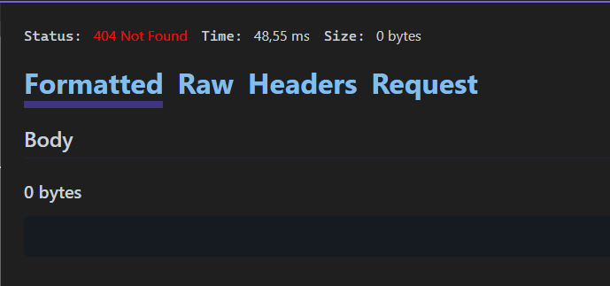
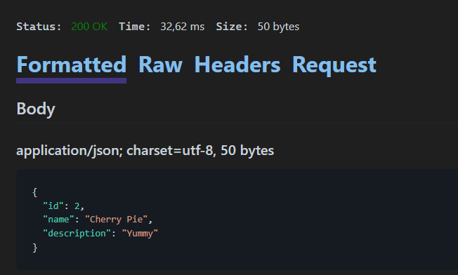
HTTP Status codes
Globally accepted standard: RFC 7231
Applying the right status code helps the consumers of your API
🌐 GET https://api.pieshop.com/pies/cherry ❌
🌐 GET https://api.pieshop.com/pies/search/name=cherry ✔️

Slide 20
Lab Connecting the database
Add Entity Framework Core support
Add a Repository class
Use the Repository in the Controller
Implement (simple) paging
Handling Exceptions
Return the correct HTTP status codes
Adding Problem Details

Slide 21
Lab Review
Service Registration
Dependency Injection
Deferred execution
ObjectResults
ProblemDetails
Developer Exceptions

Slide 22
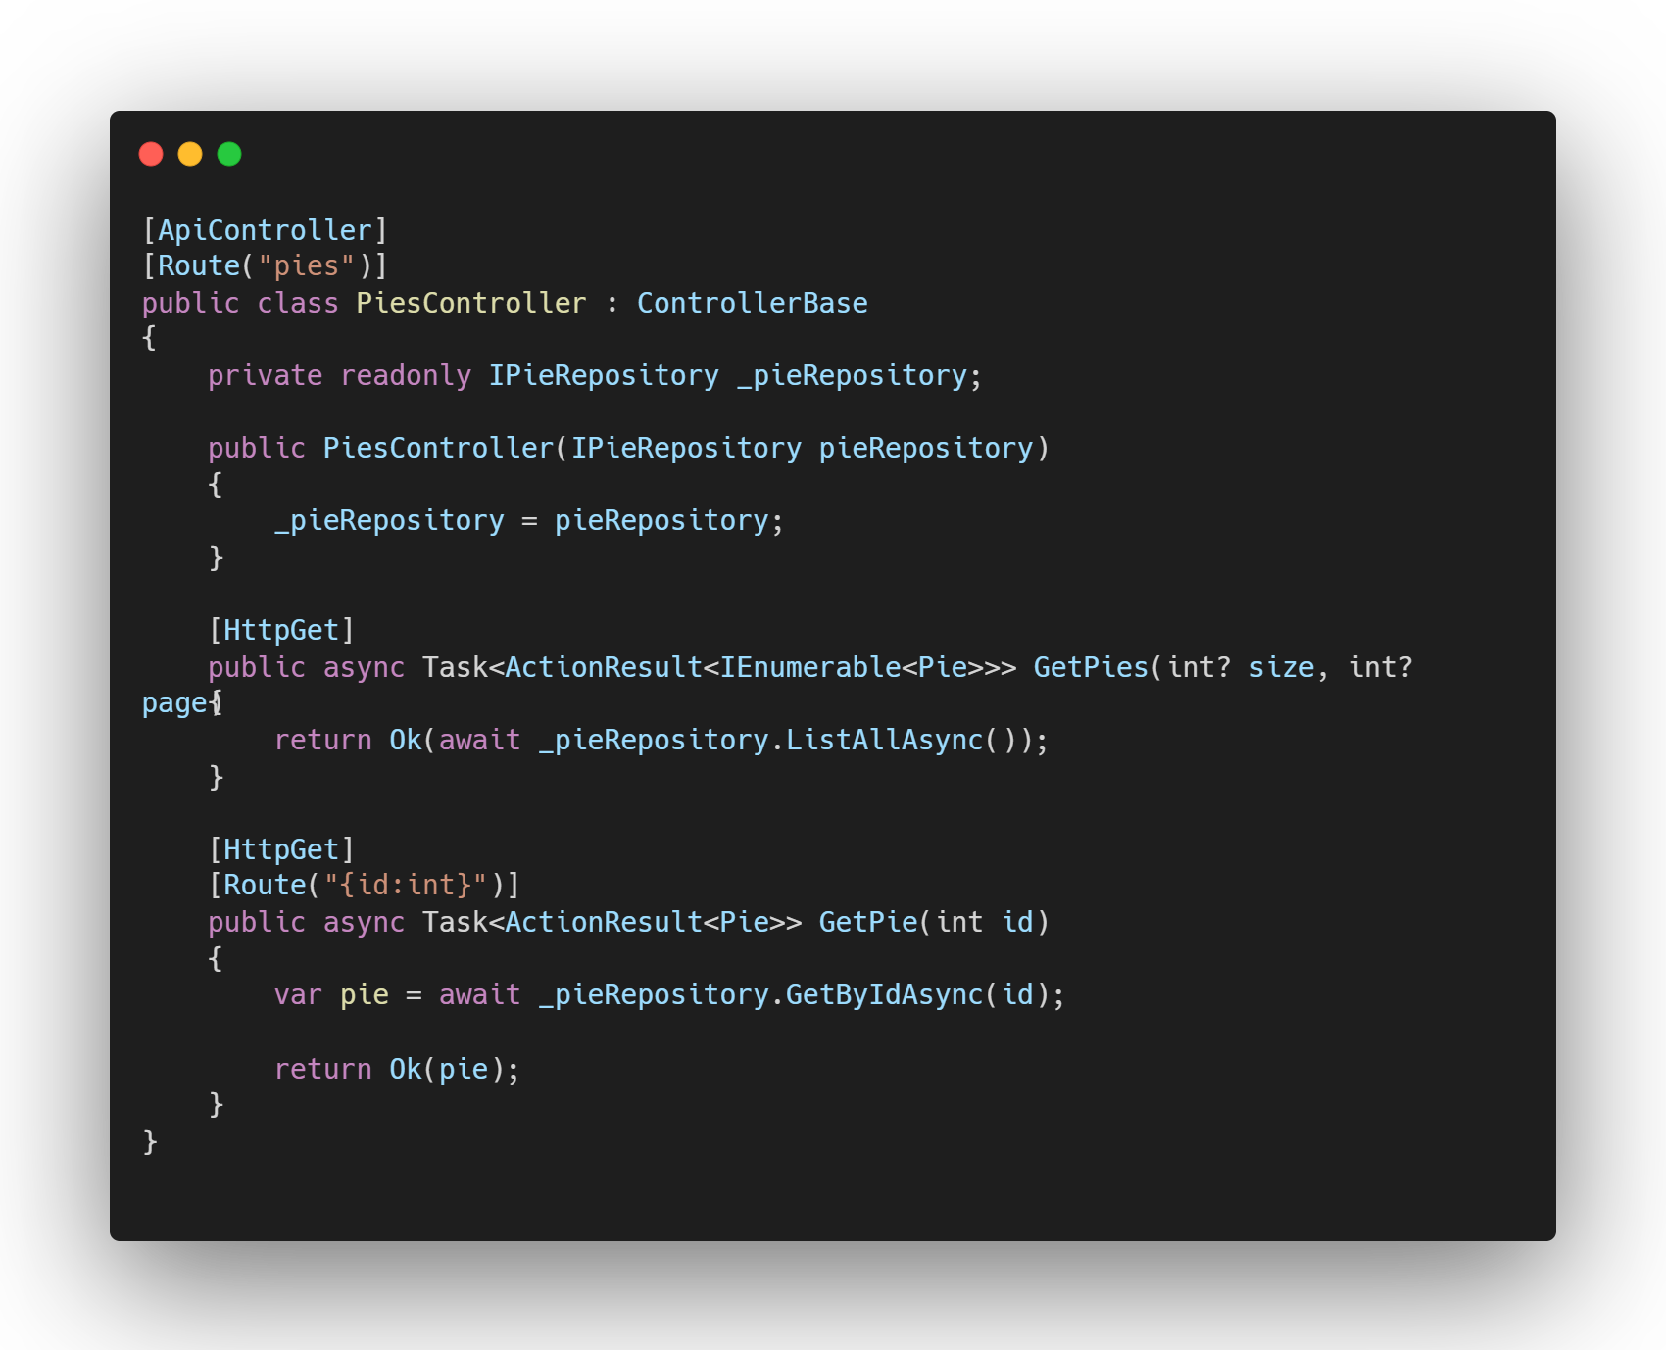
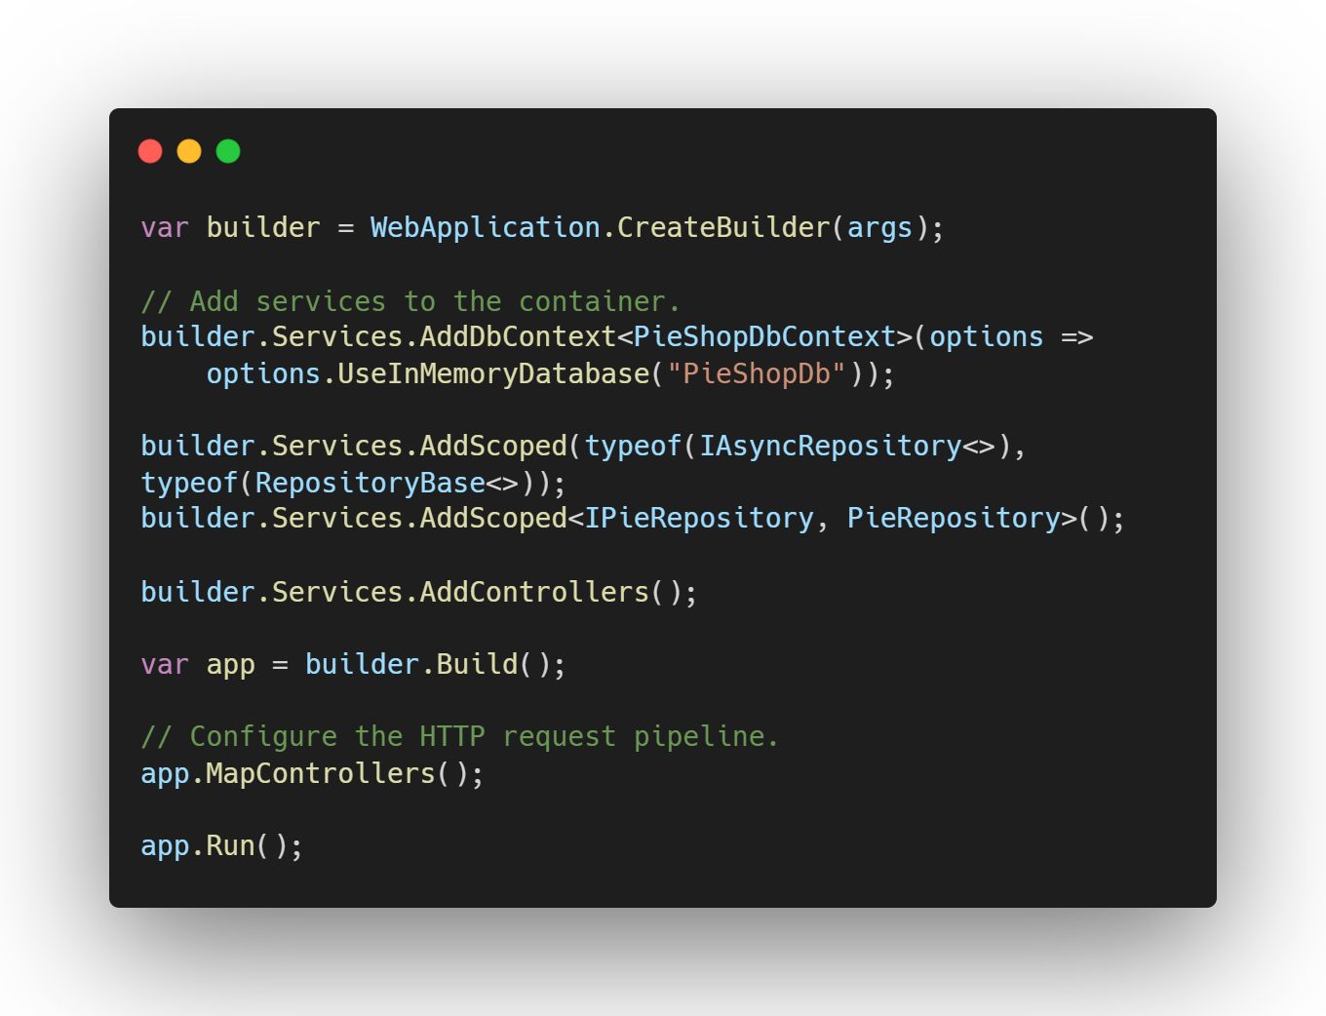
Service Registration & Dependency Injection
👈
👈
👈
👈
👈
Notes:
Constructor injection vs Parameter Injection (e.g. minimal apis) vs property injection

Slide 23
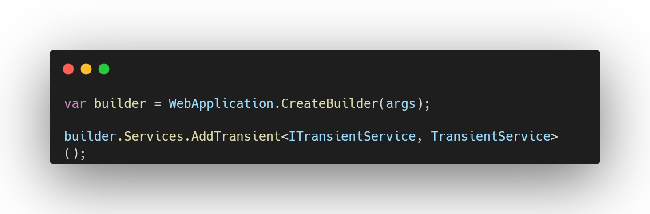
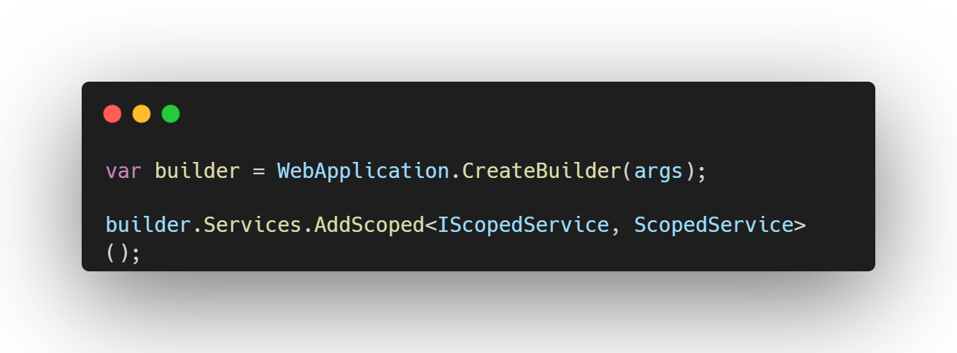
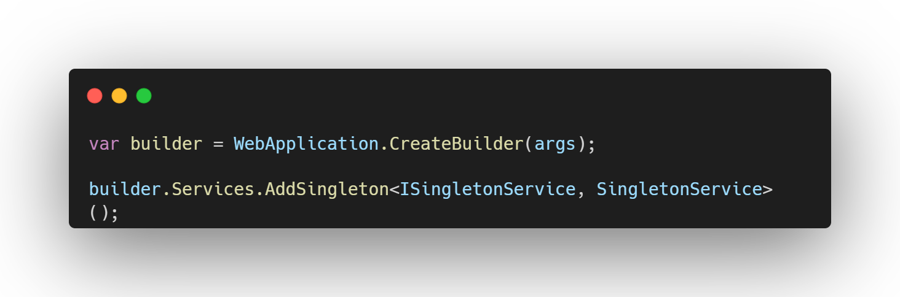
Service Registration & Dependency Injection
Lifetimes
Transient
Services are created each time they are requested
Use for lightweight and stateless services (e.g. string encoder)
Scoped
Services are created once per client request
Use when state needs to be maintained within a request , but not across requests (e.g. EF DbContext)
Singleton
Services are created on the first request and reused in subsequent request
Use for stateful services that can be reused across requests (e.g. memory cache)
❗Don’t resolve a singleton from scoped or transient

Slide 24
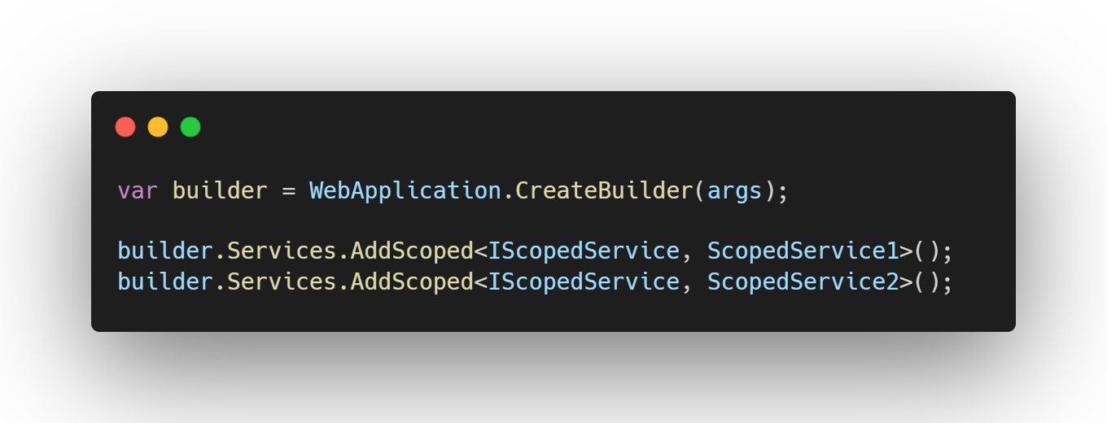
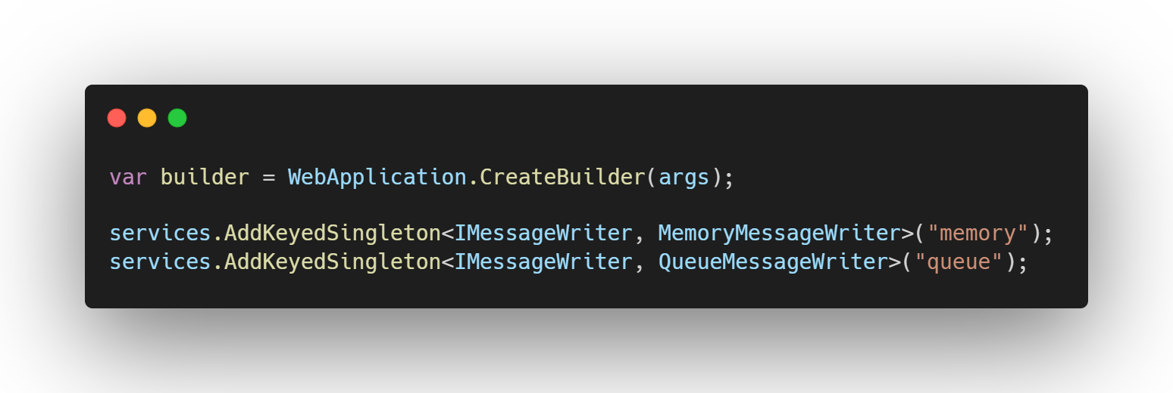
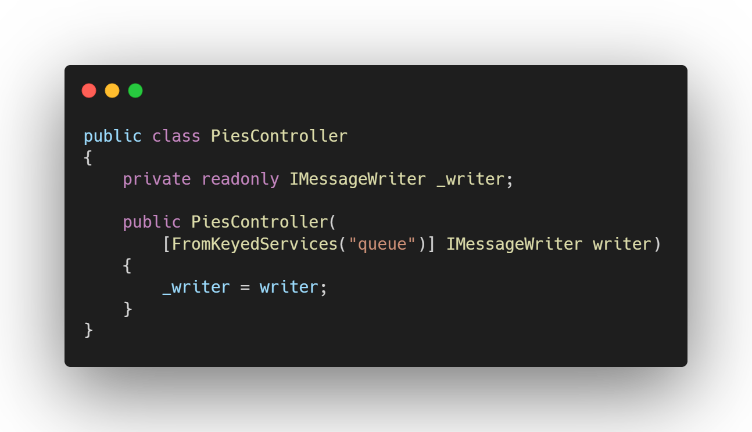
Service Registration & Dependency Injection
Keyed Services
✨ New in .NET 8
Multiple registrations of same type
All types are in the container
Last registered implementation is used
(Useful for testing)
Keyed services
All types are in the container
Reference by key which implementation to use
❌
👈

Slide 25
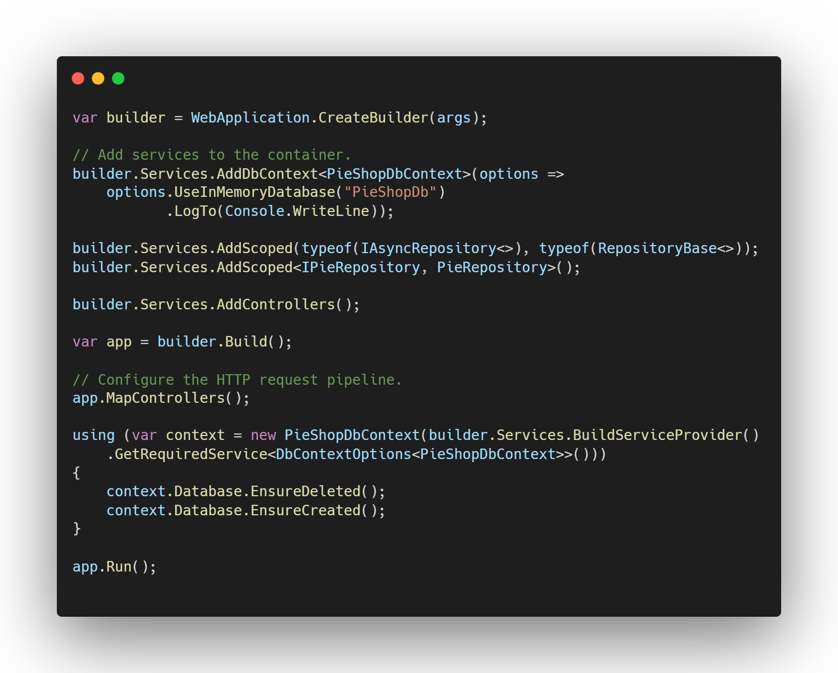
Service Registration & Dependency Injection
Resolution at startup
👈
Notes:
Demo code: do not use in production

Slide 26
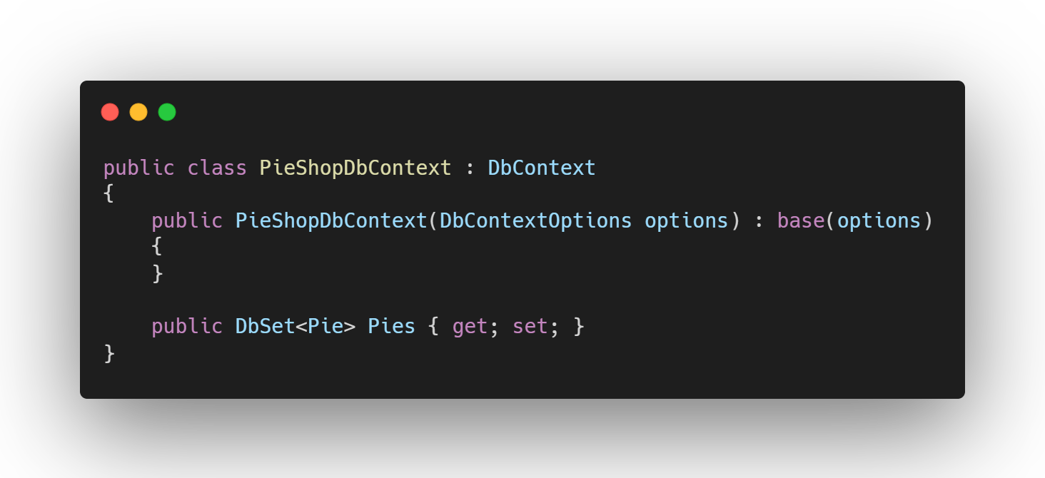
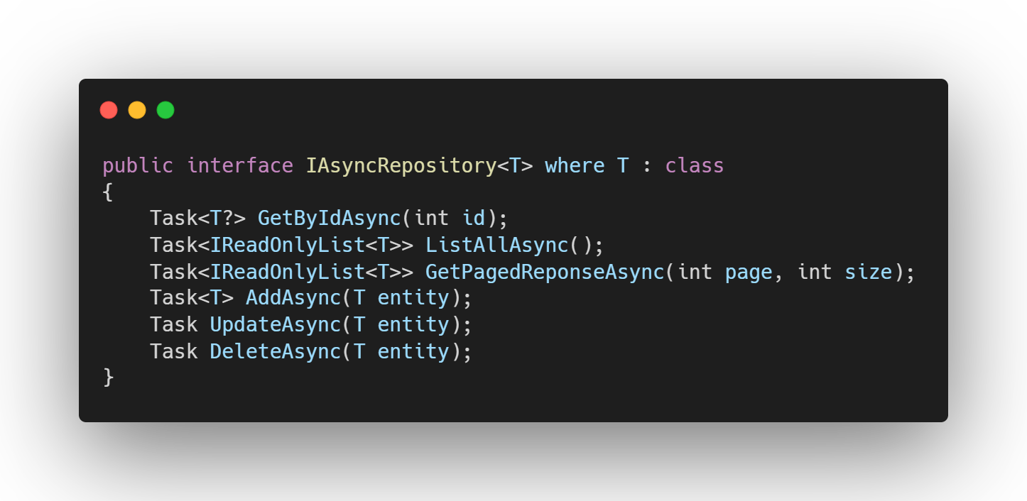
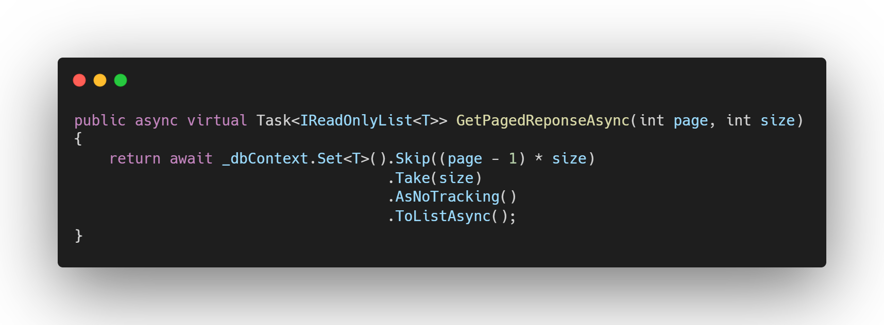
Database integration
Entity Framework Core
DbContext
DbSet
Repository Pattern
Creates consistency over all entities
Useful in API scenarios
Deferred Execution
Performance: only get the data you need
ToList, ToArray, foreach, …
👈
Notes:
Not a ef core course, but quick refresher

Slide 27
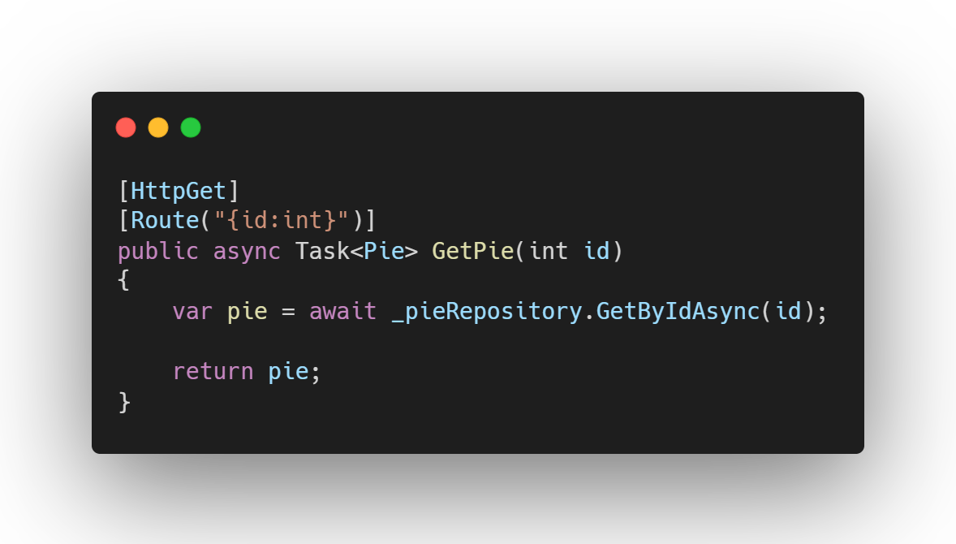
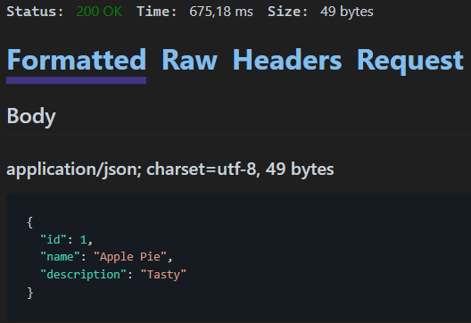
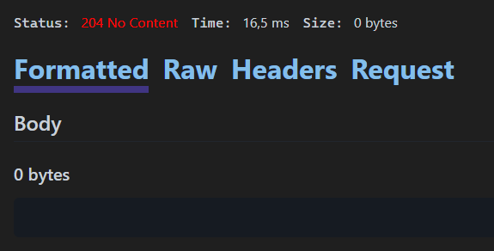
Return Types
Specific types
👈
/pies/1
👈
/pies/9000

Slide 28
HTTP Status codes
2xx Success
200 - OK
201 - Created
4xx Client Error
400 - Bad Request
401 - Unauthorized
5xx Server Error
204 - No Content
403 - Forbidden
500 - Internal Server Error
404 - Not Found
405 - Method Not Allowed
👈
Notes:
100: informational
200: success
300: redirect
400: client error
418: “I’m a teapot”
500: server error

Slide 29
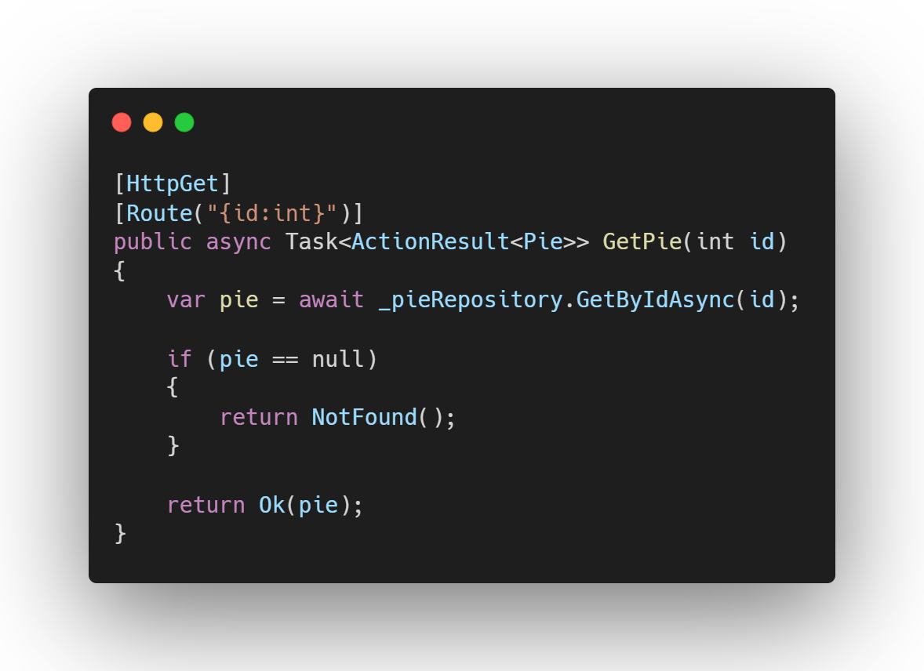
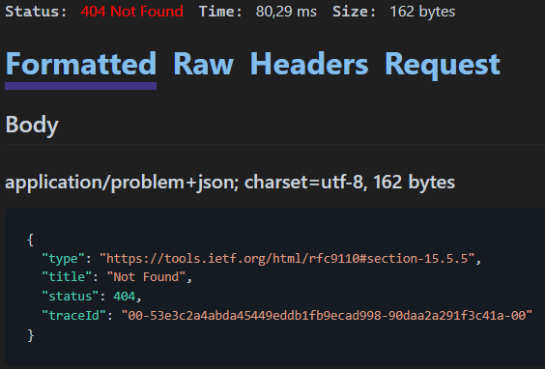
Return Types
👈
ObjectResults
ControllerBase provides proper HTTP results
return Ok(pie) ➔ 200
return NotFound() ➔ 404
return BadRequest() ➔ 400
…
ActionResult<T>
Allows multiple return types (Ok, NotFound, …)
Typed results (T = Pie)
Untyped ➔ use IActionResult
👈
👈
👈
/pies/9000

Slide 30
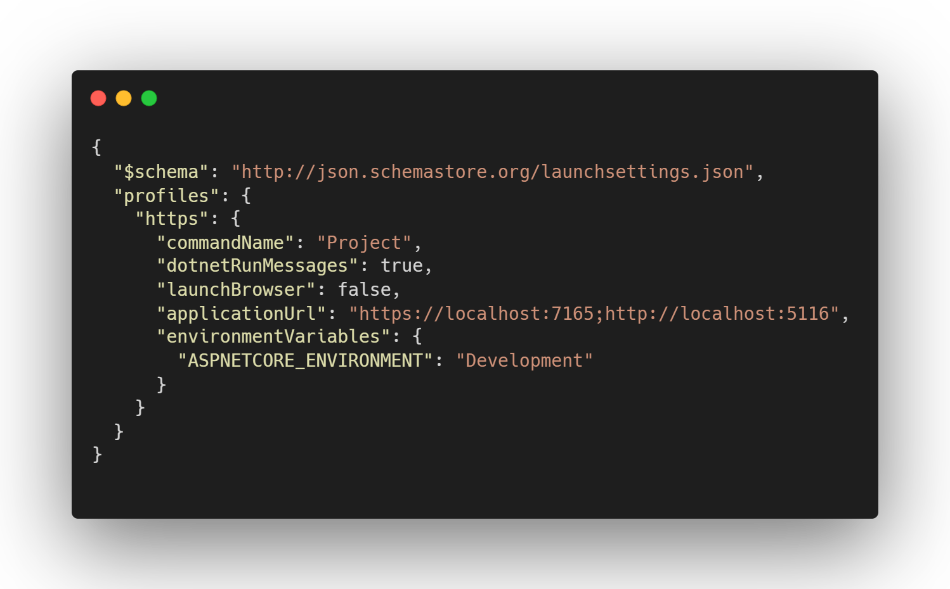
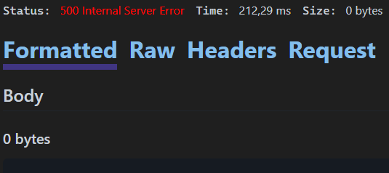
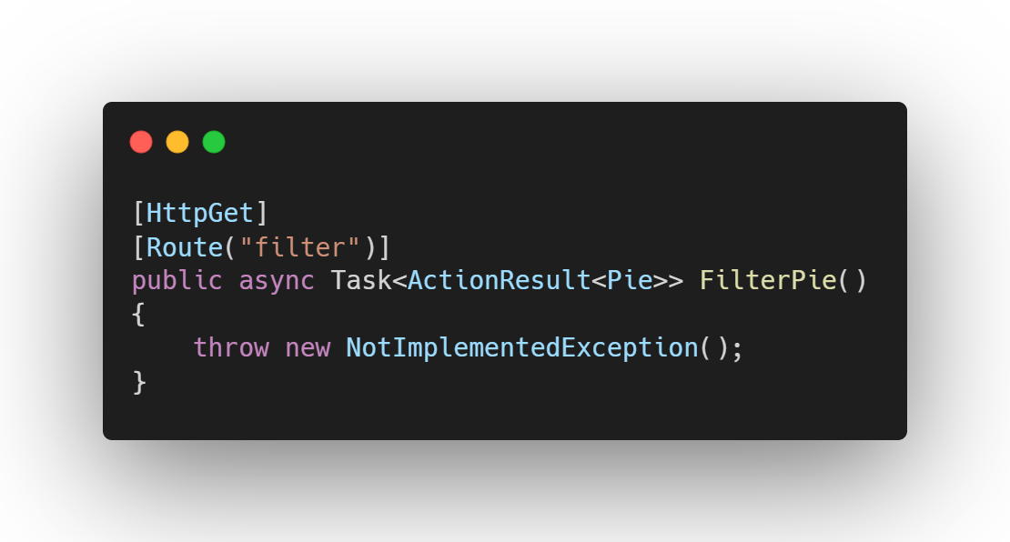
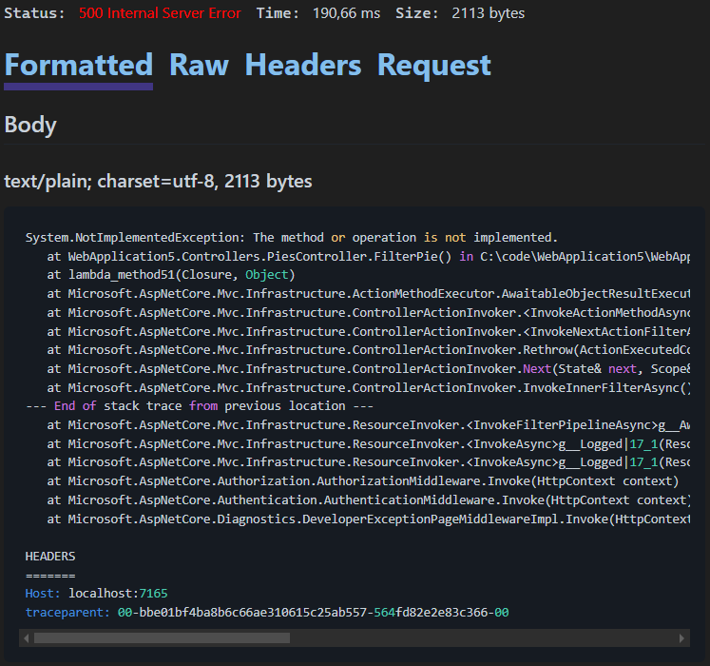
Developer Exceptions
Properties/launchsettings.json
Exposing exception information
🟢 Non-production environments
Not exposed to end-users
Local, Dev, Test, Acceptance
Exception information helps debugging and bug fixing
🔴 Production environment
Exposed to end-users
Staging, Production
Exception information gives inside into how your code works
Could be used to find a security weakness and exploit it 🦹
Exceptions (including stack trace) can be logged for trouble shooting
👈
Production
Development
Notes:
Staging: deployment slots with blue/green deployment

Slide 31
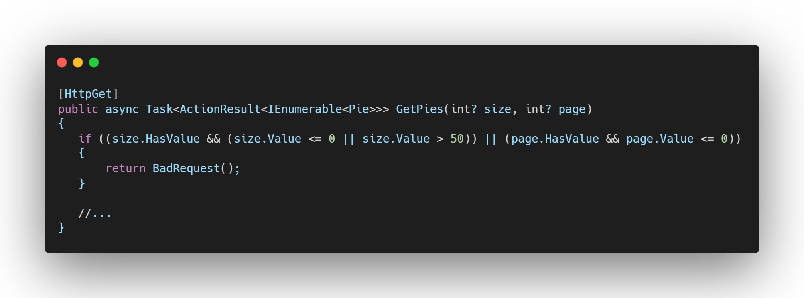
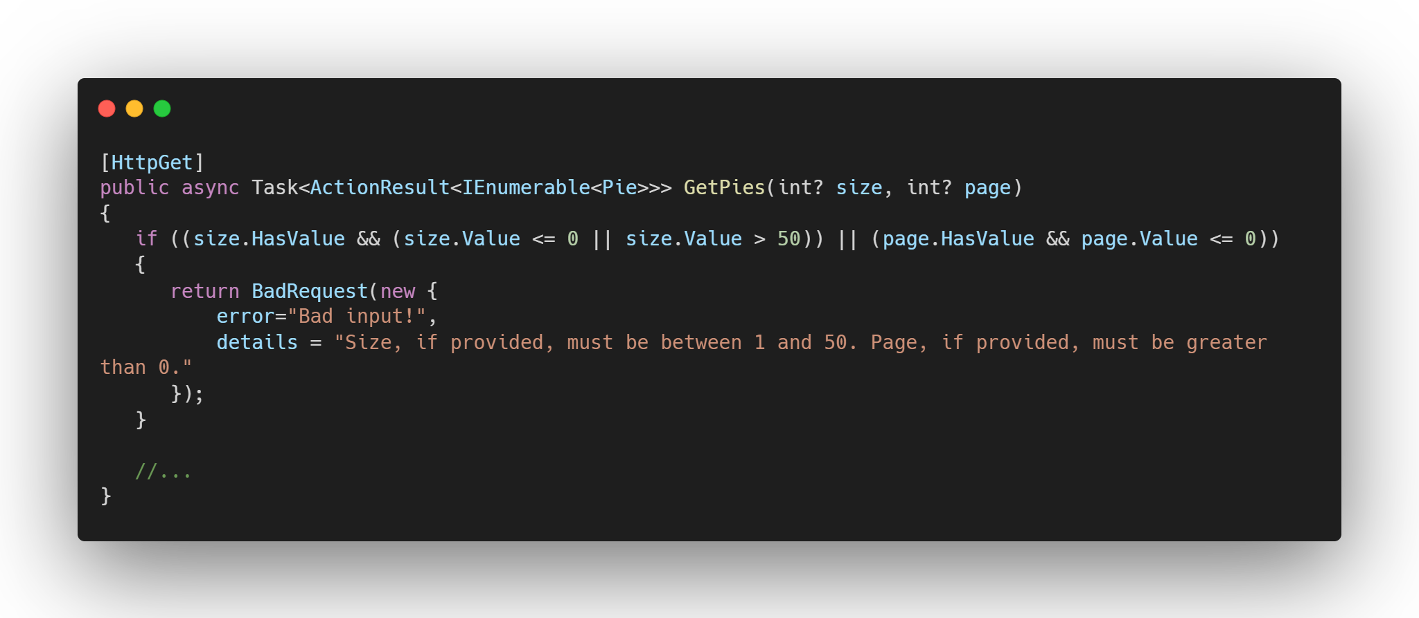
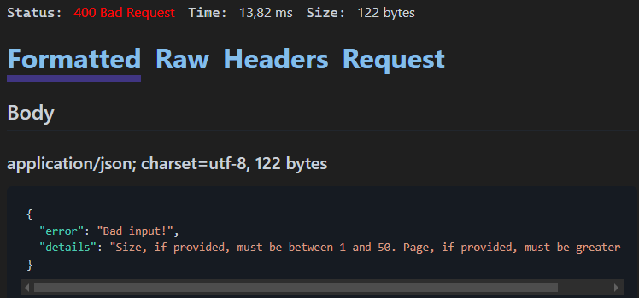
Give Errors extra context
Overloads on ObjectResults
➔ Pass extra info

Slide 32
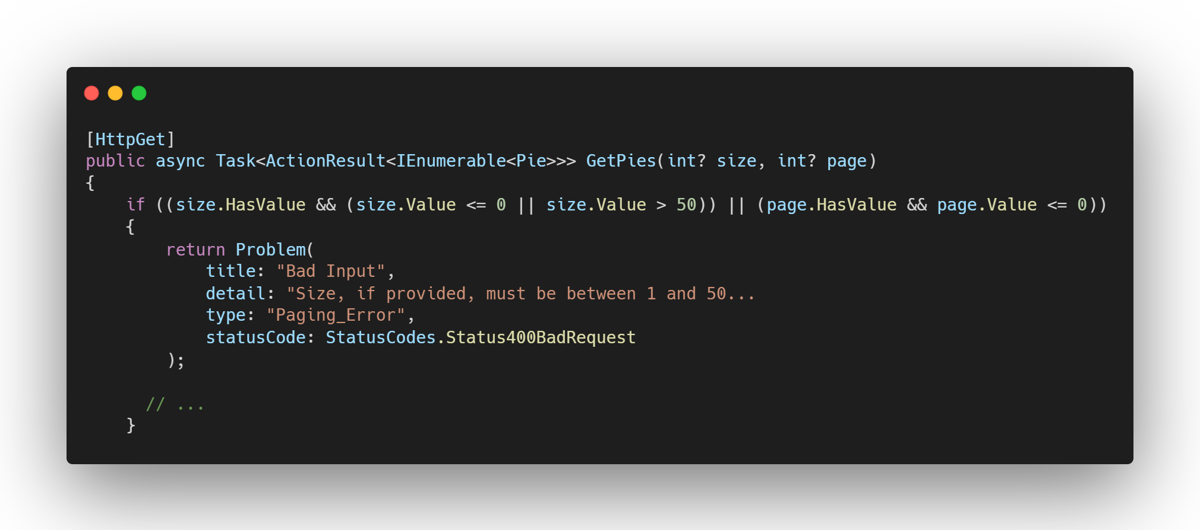
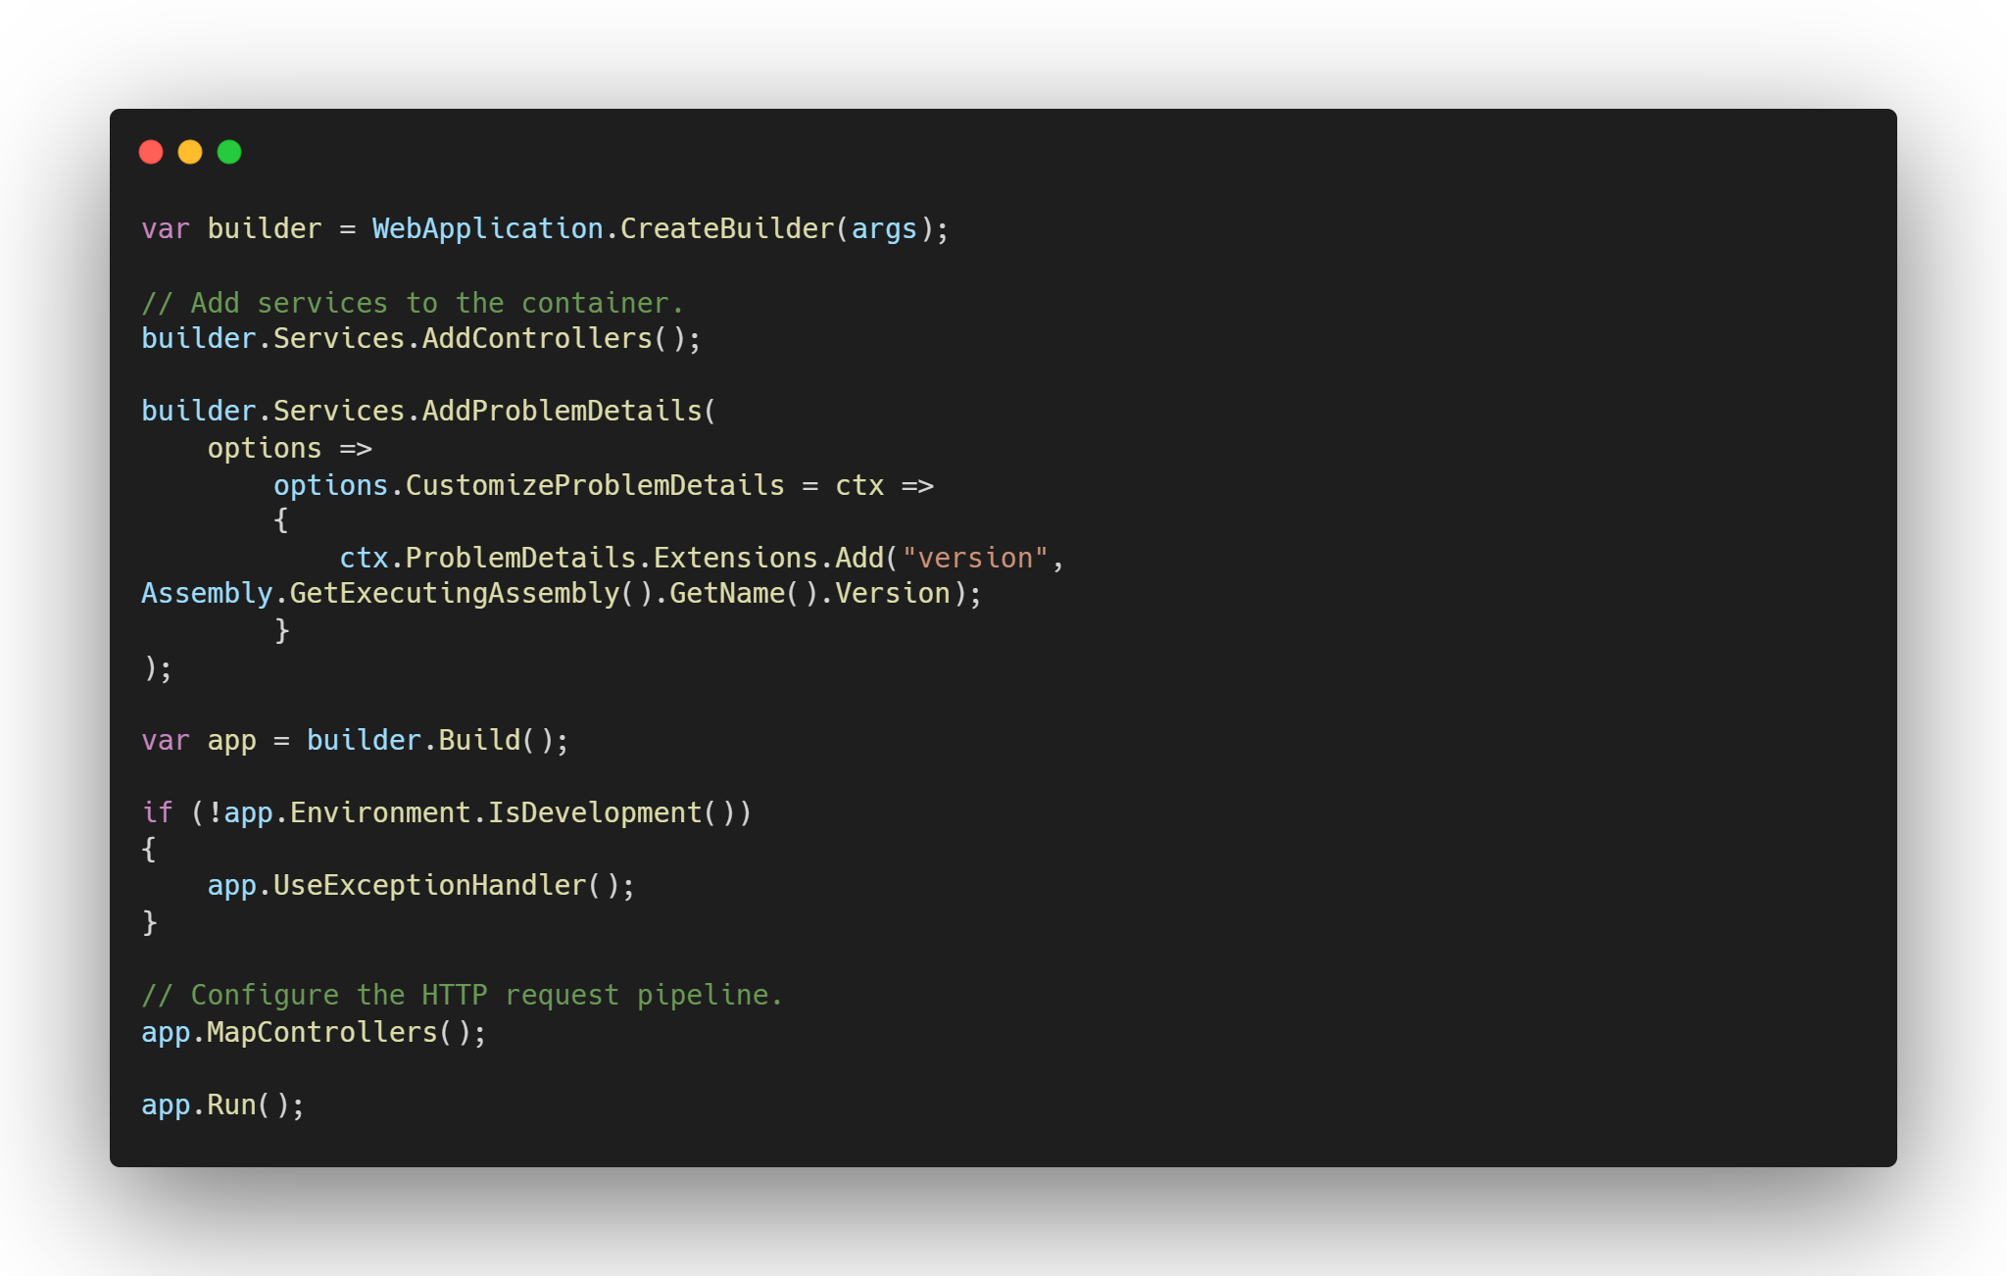
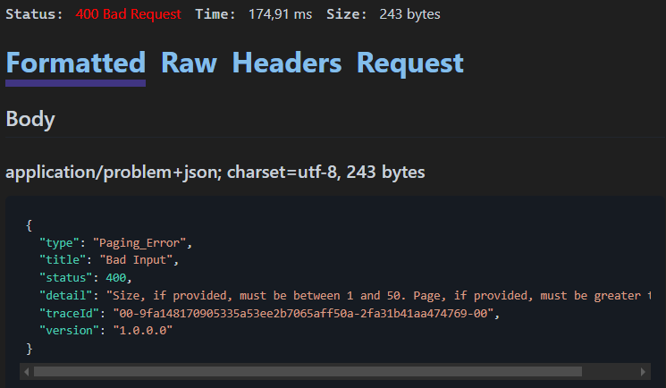
Problem Details
👈
Standard: RFC 9457
Machine readable details of errors in HTTP Responses ➔ standardized response body
Allows for addition of extra info
/pies?page=1&size=500
👈

Slide 33
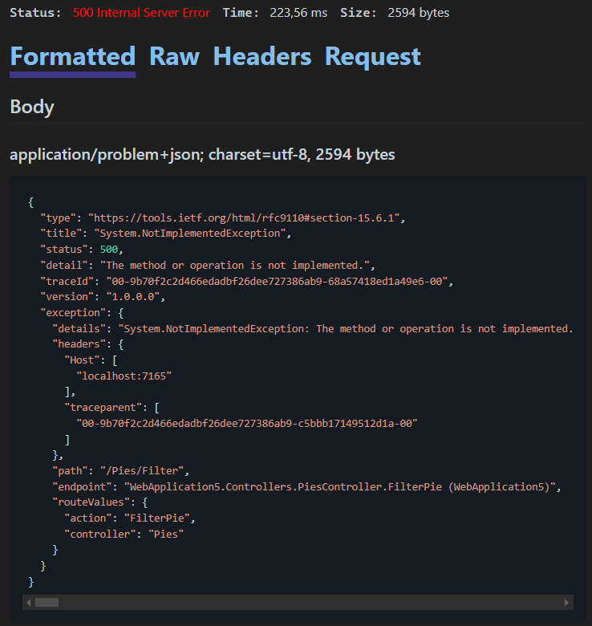
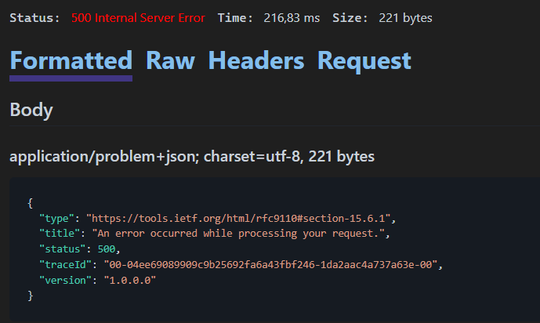
Problem Details & Developer Exceptions
Development
Production

Slide 34
Lab Managing data
Adding data
Validating the input
Updating data
Deleting data

Slide 35
Lab Review
HTTP Verbs
POST
PUT
DELETE
Request body
Response header
Validation

Slide 36
HTTP Verbs
GET
Read a resource
Idempotent ✔️
POST
Create a resource
Idempotent ❌
PUT
Update a resource
Idempotent ✔️
DELETE
Safe ✔️
Cacheable ✔️
Safe ❌
Cacheable ❕
Safe ❌
Cacheable ❌
Delete a resource
Idempotent ✔️
Safe ❌
Cacheable ❌
Notes:
Idempotent: can be called multiple times with the same outcome
Safe: does not modify a resource
Cacheable: can the resource be cached of prefetched without adverse impact on that resource?
Post is cacheable if response contains explicit freshness info

Slide 37
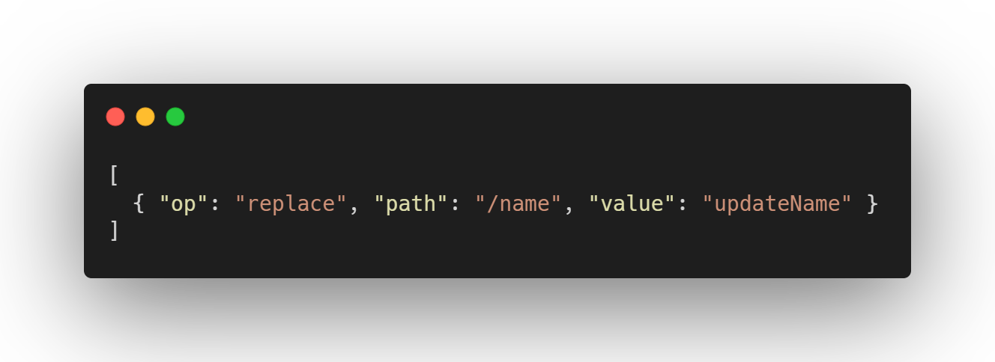
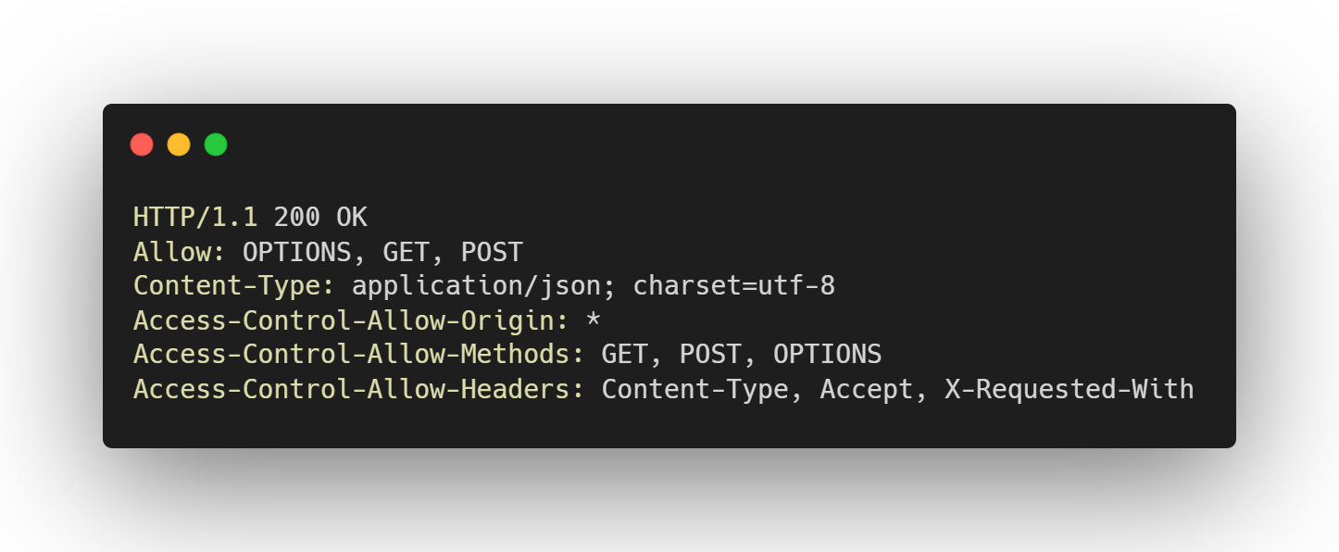
Other HTTP Verbs
PATCH
Support for partial updates
HTTP PUT replaces the entire resource
Request body contains a collection of patch operations
HEAD
Request the headers that would be returned for a HTTP GET
Useful to retrieve metadata, without returning the entire payload
OPTIONS
Request the communication options the API supports
E.g. which HTTP verbs are supported

Slide 38
Model binding
Controllers work with data from the HTTP requests:
Route data
Query string
Request body 👈
Form fields
Headers
Uploaded files
👈

Slide 39
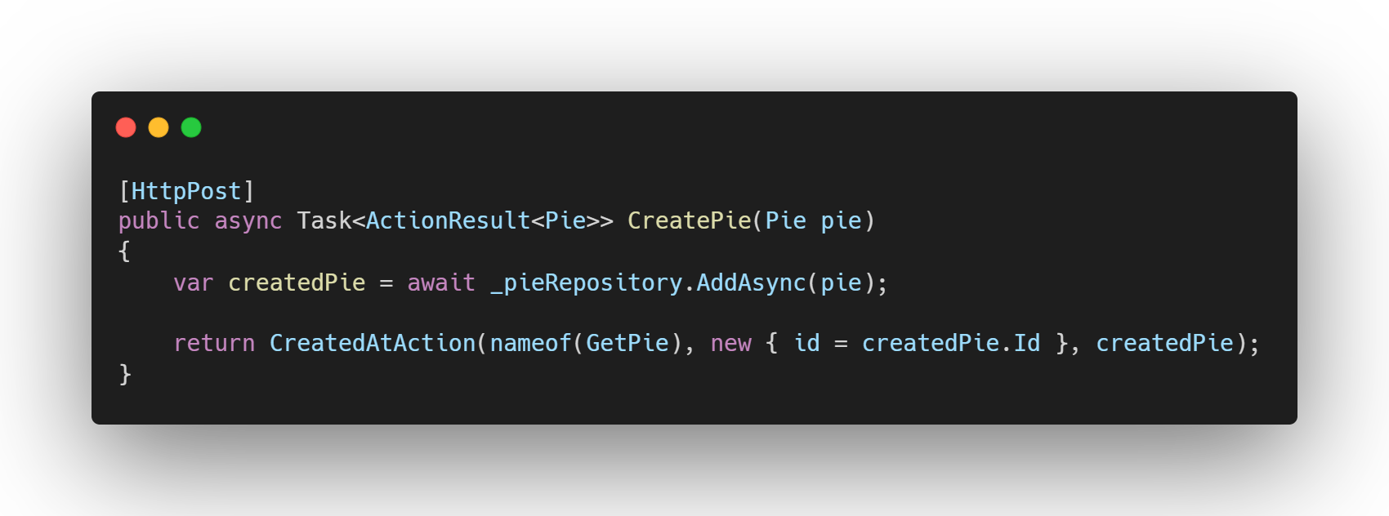
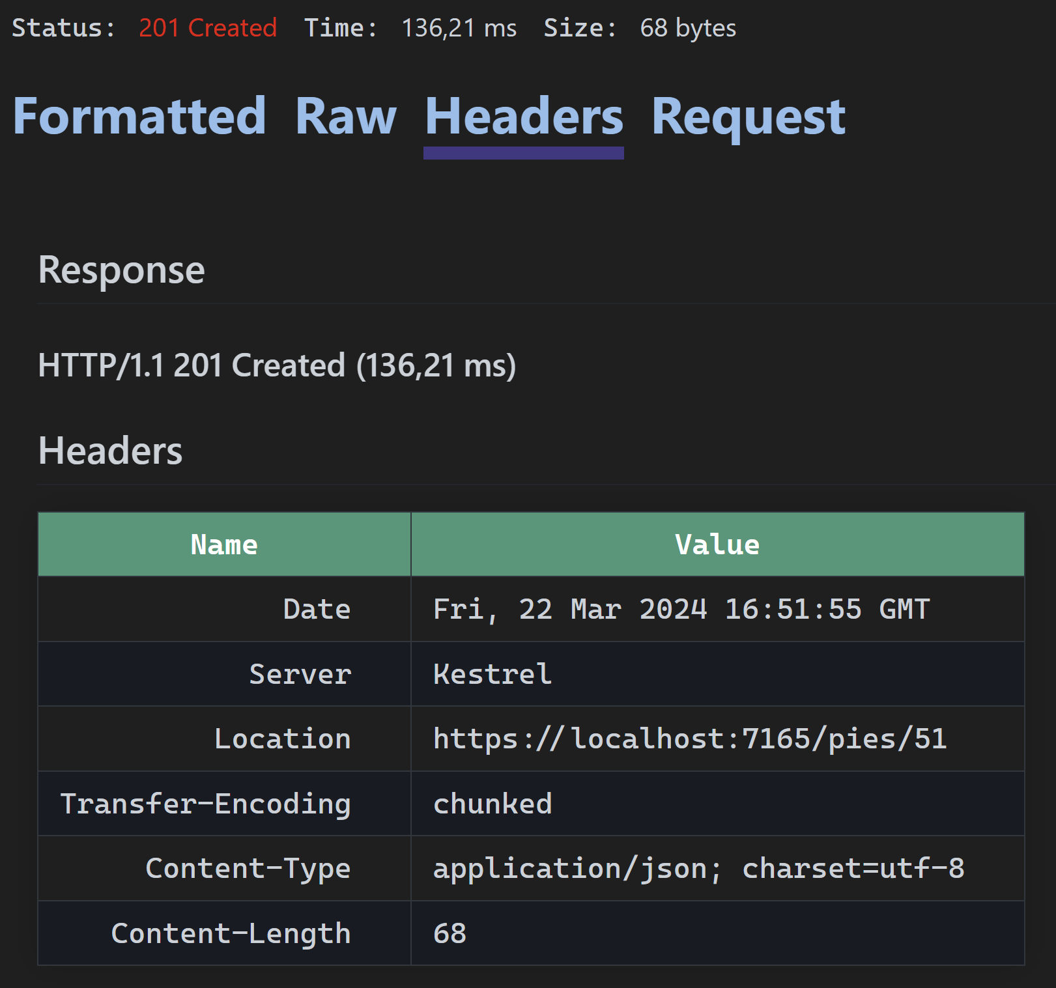
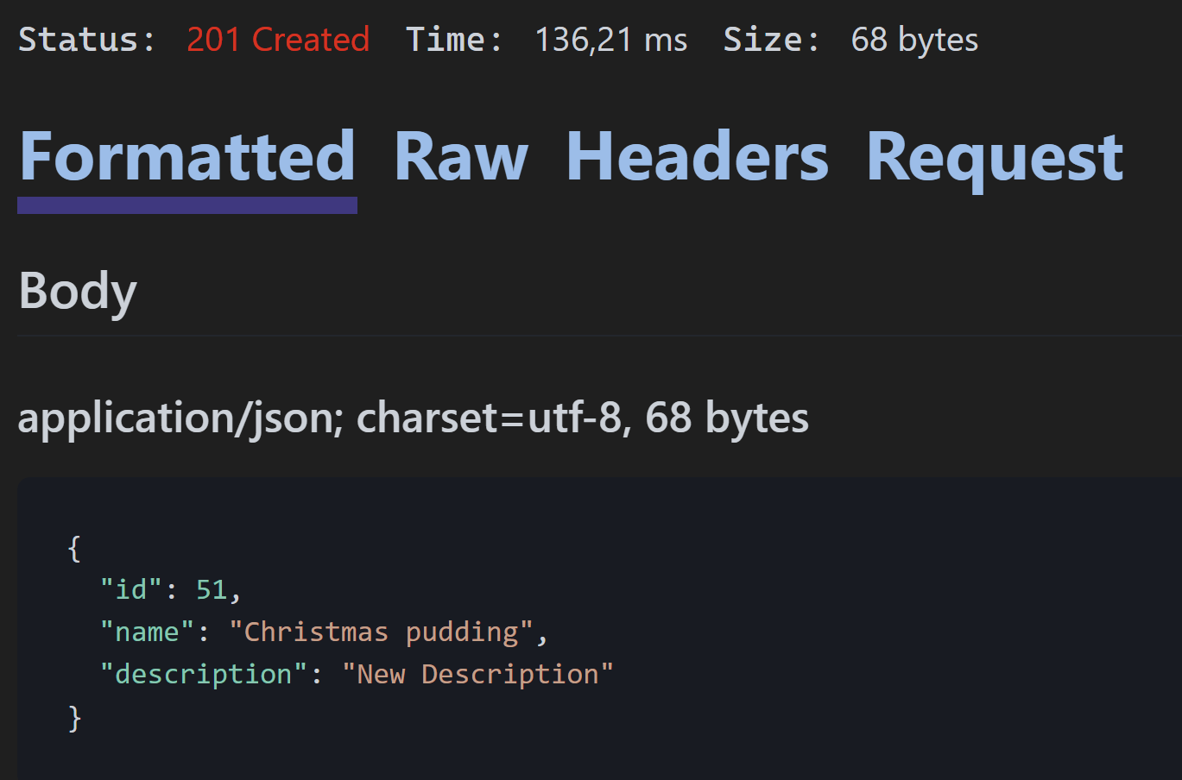
Adding a new resource
🌐 POST https://api.pieshop.com/pies Content-Type: application/json {
“name” = “Christmas pudding” “description” = “Festive”
}
Method
Domain
Route
👈
Request body
👈

Slide 40
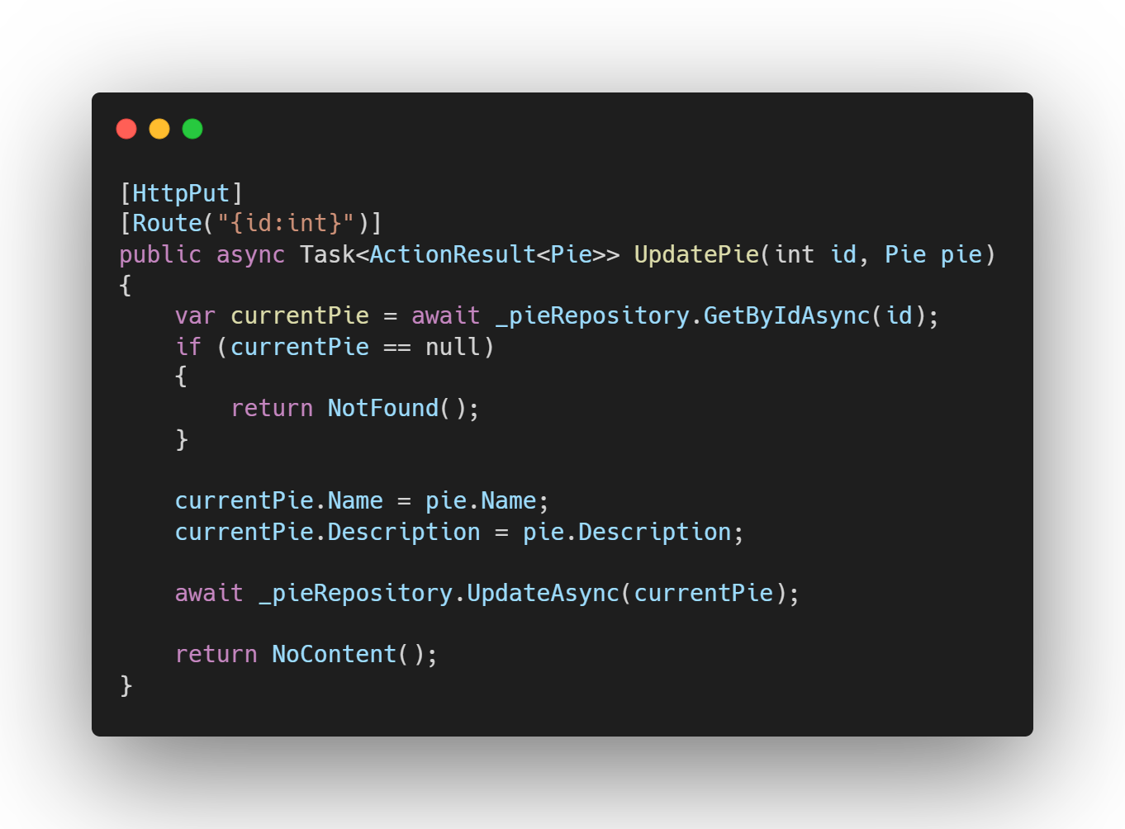
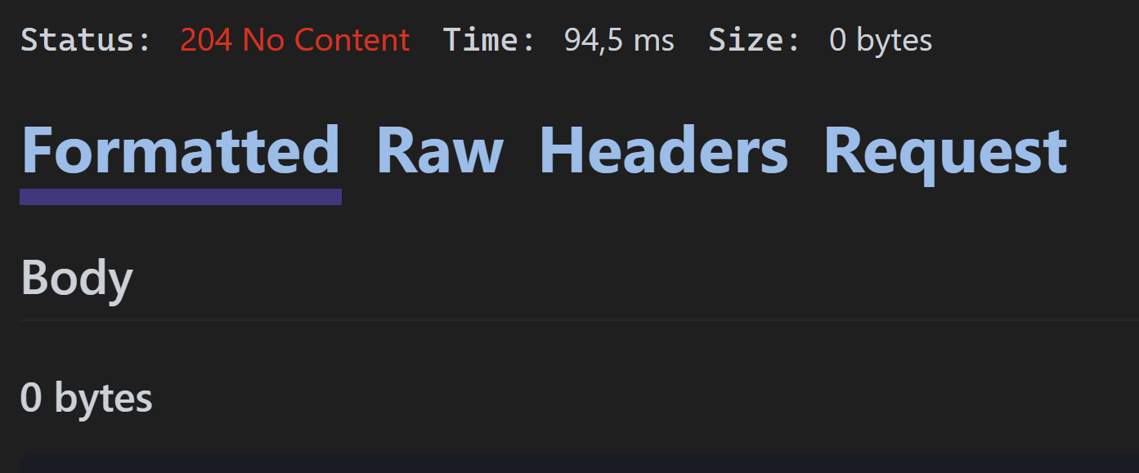

Updating an existing resource
🌐 PUT https://api.pieshop.com/pies/51 Content-Type: application/json {
“name” = “Xmas pudding” “description” = “Festive”
}
Method
Domain
Route
Request body
/pies/51
/pies/9000
👈
👈

Slide 41



Deleting an existing resource
🌐 DELETE https://api.pieshop.com/pies/51
Method
Domain
Route
/pies/51
/pies/9000
👈
👈

Slide 42


Validating input
👈
Data Annotations
Validation used by ASP.NET Core during model binding
Configuration used by Entity Framework Core during migration
ModelState
Implicitly handled by [ApiController] attribute
Explicitly
👈
👈
👈

Slide 43

Validating input
👈
🌐 POST https://api.pieshop.com/pies Content-Type: application/json {
“name” = null “description” = “Festive”
}
❗ Validation Error ➔ validation on the model fails
👈

Slide 44

Validating input
👈
🌐 POST https://api.pieshop.com/pies Content-Type: application/json {
“description” = “Festive”
}
❌ Model binding error: ➔unable to match the payload with the model
👈

Slide 45
Lab Working with files
Download a file
Upload a file

Slide 46
Lab Review
Content Type
application/octet-stream
FileExtensionContentTypeProvider
Validating a file

Slide 47
Model binding
Controllers work with data from the HTTP requests:
Route data
Query string
Request body
Form fields
Headers
Uploaded files
👈

Slide 48


Returning an existing file
👈
👈
👈
Notes:
Show the overloads of FileResult

Slide 49



Creating a new file
👈
👈
👈
👈
👈

Slide 50
Lab Connecting a UI
Creating a Console Application to interact with our API

Slide 51
Lab Review
HttpClient
JSON Serializer

Slide 52

Console App Getting all pies
👈
👈
👈
Notes:
ReadFromJsonAsync

Slide 53

Console App Adding a new pie
⚠️Best practice: use IHttpClientFactory to prevent Socket Exhaustion
👈
👈
👈
👈
Notes:
Use the IHttpClientFactory - .NET | Microsoft Learn
→ Socket exhaustion
→ Typed clients

Slide 54


